Slide 1
Upgrading from AngularJS 1 to Angular 2+
Jake Adams

Slide 2
About Me
Jake Adams
Father / Husband
Senior Software Architect - Thompson Coburn LLP
twitter - @jacobladams
http://github.com/jacobladams

Slide 3
Overview
Setup
Preping for Migration
Migrating using ngUpgrade
More

Slide 4
Vocabulary
AngularJS vs. Angular
Upgrade vs. update vs. migration

Slide 5
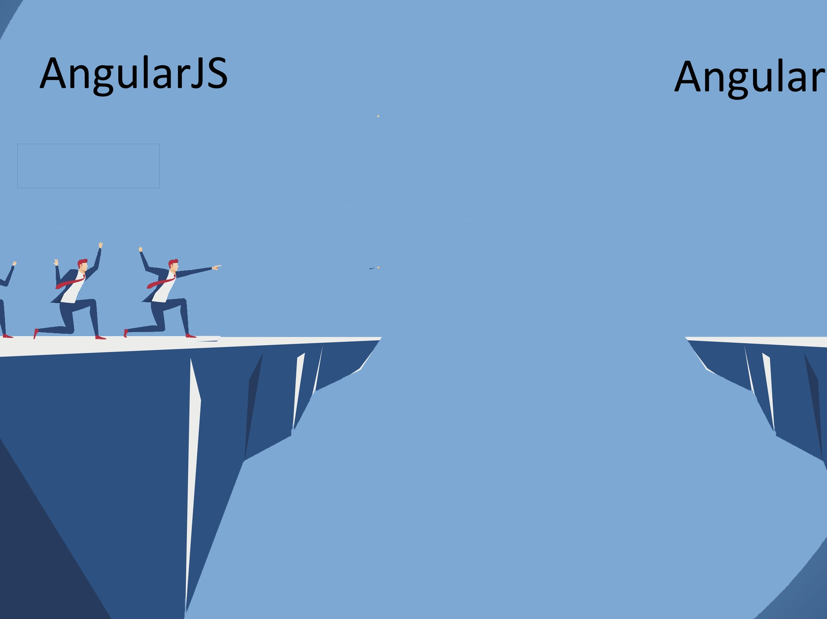

Slide 6
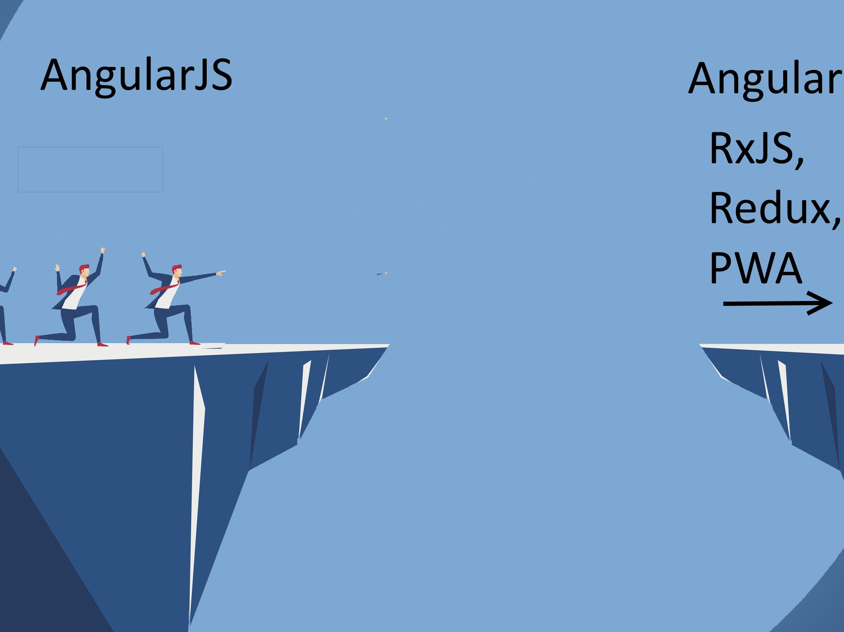

Slide 7
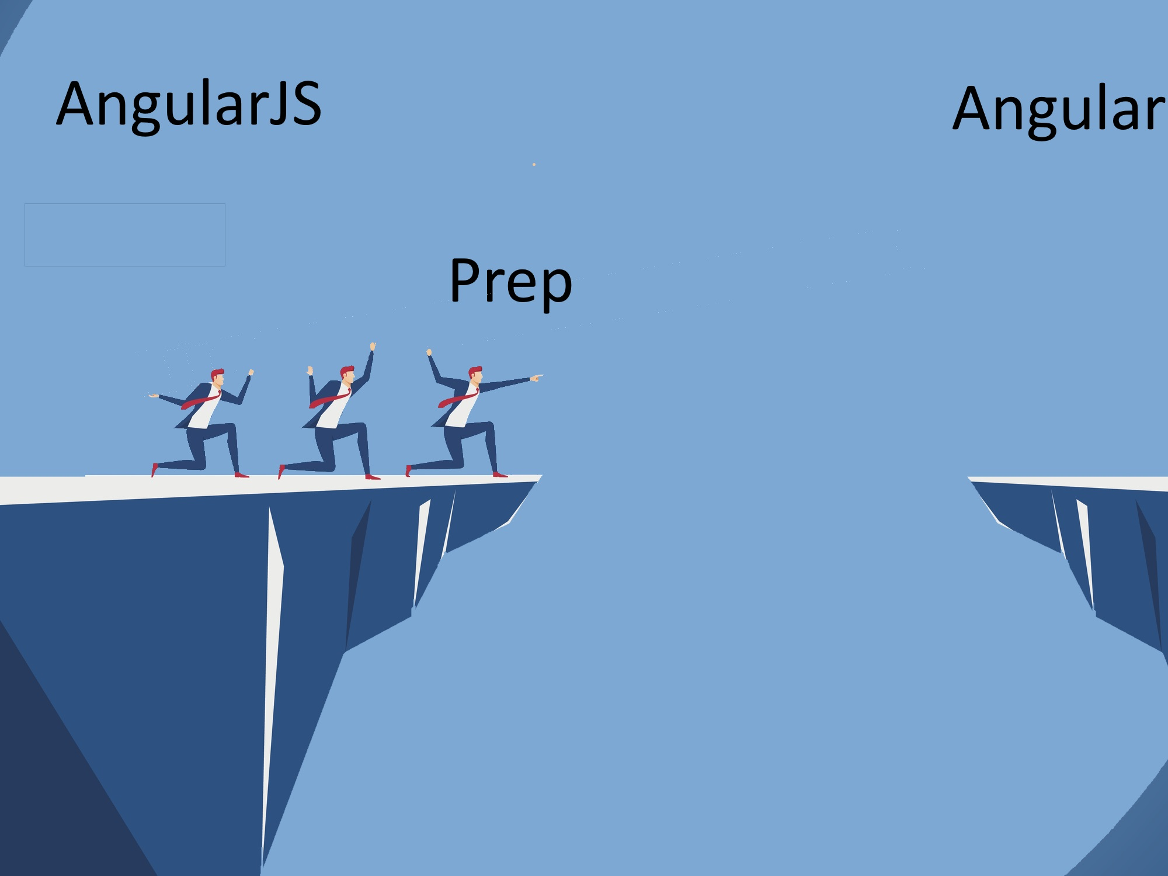

Slide 8
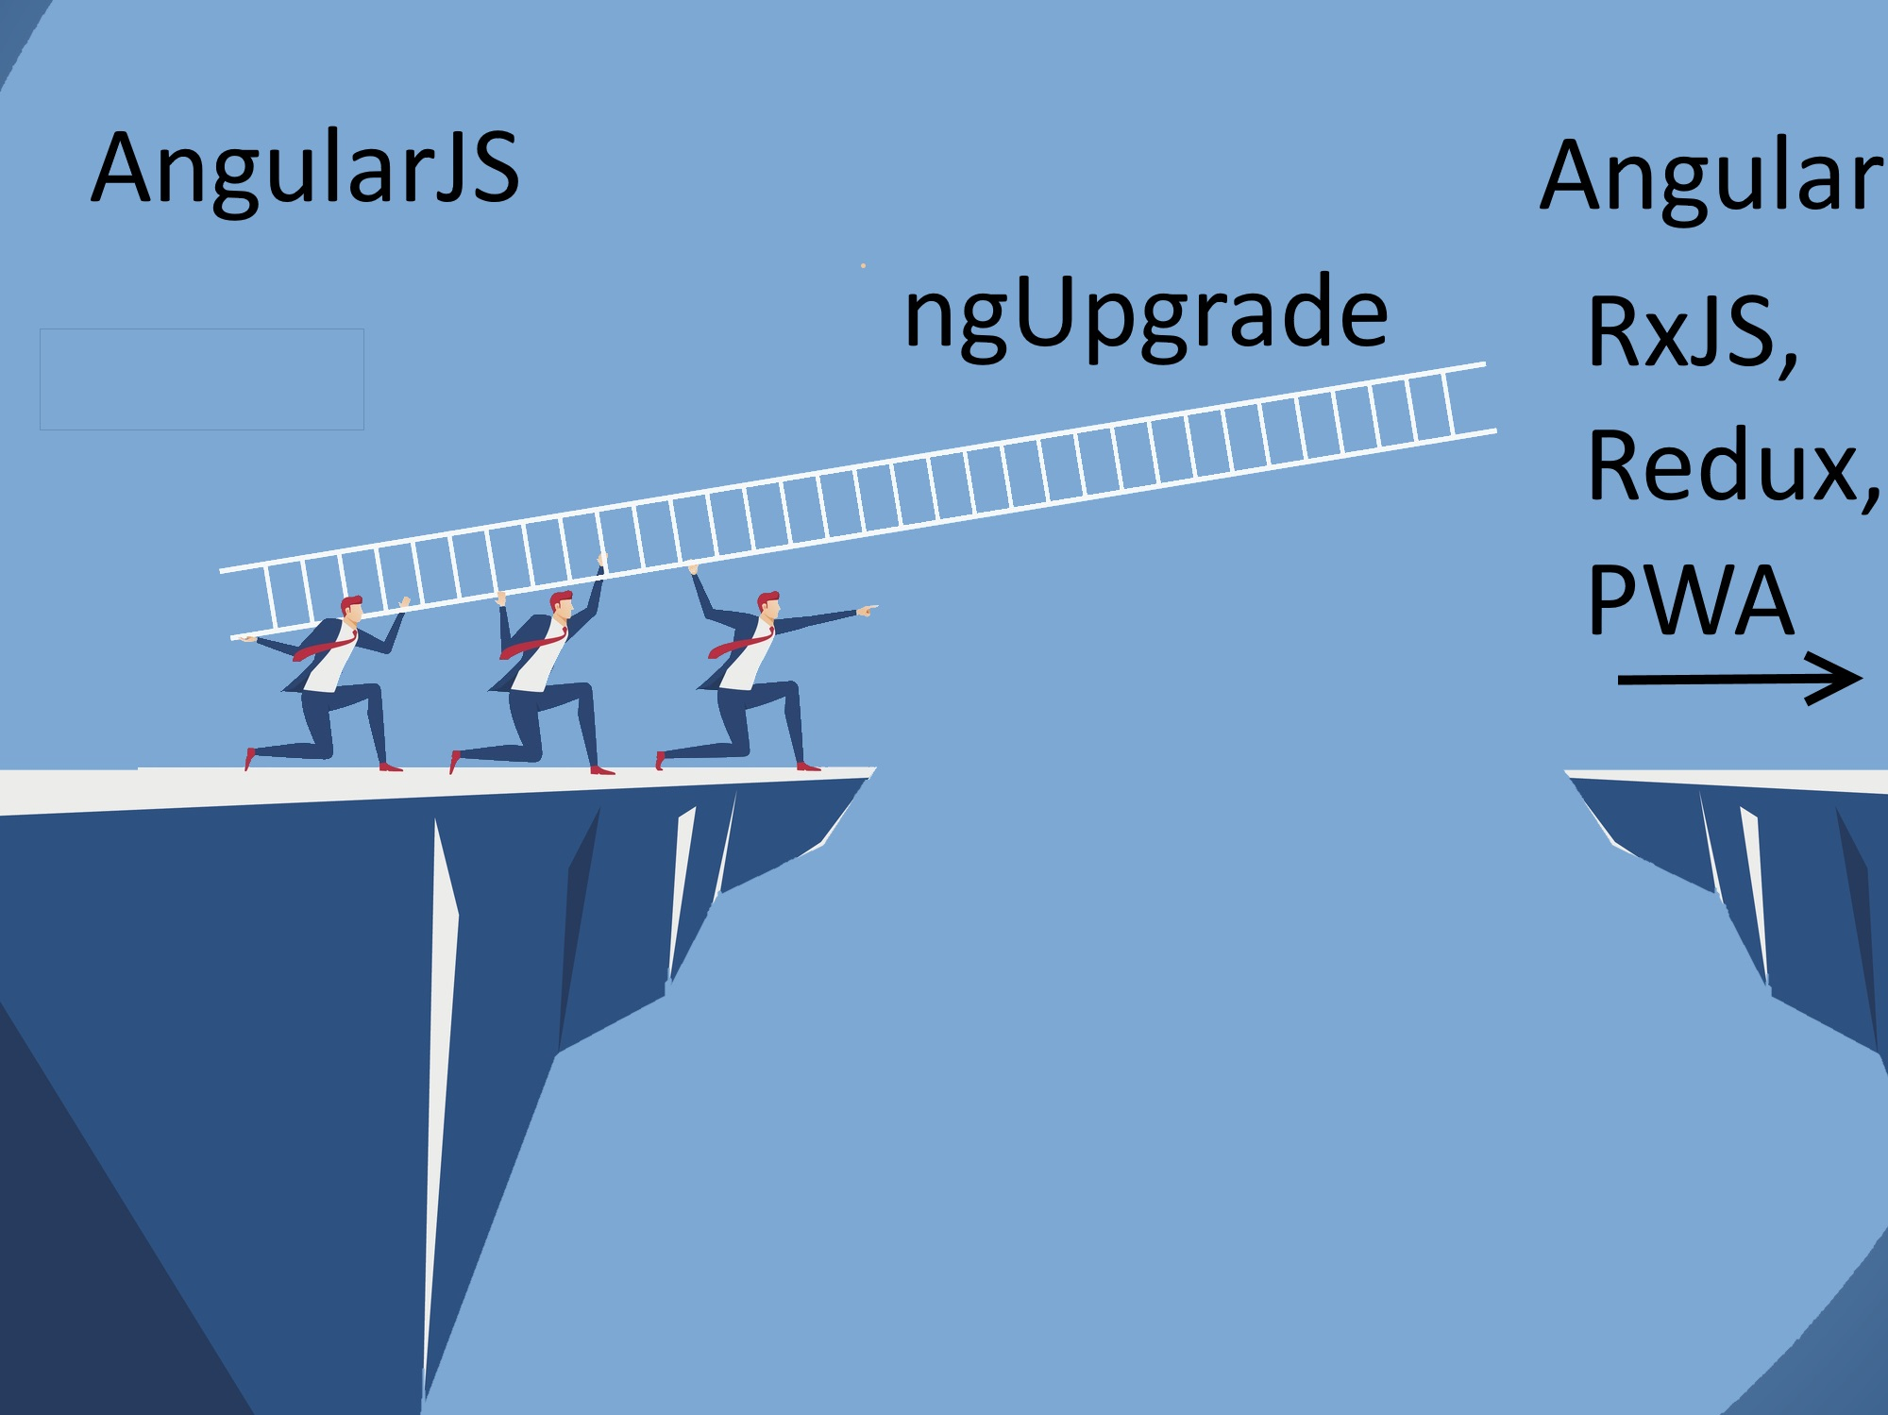

Slide 9
Why Angular 2
Faster
Simpler
Future Focused

Slide 10
But I Don’t Want To!

Slide 11
Option #1: Stay on Angular JS 1.X
AngularJs 1.7.X
Jan 1 – June 30, 2018 – Active Development
Jul 1 2018 – June 30, 2021 Long Term Support (LTS)
On July 1st 2018, … we will focus exclusively on providing fixes to bugs that satisfy at least one of the following criteria:
A security flaw is detected in the 1.7.x branch of the framework
One of the major browsers releases a version that will cause current production applications using AngularJS 1.7.x to stop working
The jQuery library releases a version that will cause current production applications using AngularJS 1.7.x to stop working.
Related Blog Post

Slide 12
Option #2: Go to Another Framework
React
Vue
Ember
Aurelia
Knockout
Hyperapp
Polymer
Backbone

Slide 13
Ok, fine. I’ll migrate

Slide 14
Migration Options
Rewrite
ngUpgrade

Slide 15
Why ngUpgrade
Keep system up
Reduce risk
Steady upgrade

Slide 16
Demo Architecture

Slide 17
Bootstrap

Slide 18
Service

Slide 19
Components

Slide 20
Components - 2

Slide 21
All Components and Services

Slide 22
Router

Slide 23
All Routes

Slide 24
Further Steps
RxJS
Redux
Lazy Loading
Progressive Web App (PWA)
Plenty Others

Slide 25
Additional Resources / Questions
Pluralsight couses
Preparing for Migration from AngularJS (1.x) to Angular (2+)
Migrating Applications from AngularJS to Angular
Webinar – Strategies for migrating in Angular
Angular Docs – Upgrading from AngularJS to Angular
Dor Moshe - Angular v4: Hybrid Upgrade Application

